Slide 1

Research Design II
IT- BAN-6.3A Ismael Ben Daoud

Slide 2
Introduction
Research Topic:
The main topic of this research is machine learning. Which focuses on focuses on the use of data and algorithms to imitate the way that a user can learn and improve accuracy. The Theme will concentrate on the close price of investment.
Significance:
The research has a great interest in both software and business aspects. As a business analytics student, it is a great opportunity to develop a project-based on both software and business sector combined together while also using different techniques of analysing the effects of forecasting on the markets through the use of machine learning.
Rational:
Increasing importance of machine learning in various industries.
Practical implications of accurately classify markets

Slide 3

Research Questions and Hypothesis
Hypothesis: “maximising profits by implementing machine learning to improve decision making from predictions using past data and current exchange rates”.
Research Questions:
Are movements in rates of stock exchange markets predictable when taking into consideration past datasets with exchange rates?
Can machine learning contribute to an optimal decision making when dealing with stock exchange?
Significance of Hypothesis:
Previous studies shown high accuracy in stock markets using RNN.
Testing the hypothesis contributes to better understand the stock market and provide a more refined experience for future trading.
Importance of Research Questions:
Compare results with existing solutions
Explore the impact of dataset size on algorithm accuracy
Accuracy assessment of LSTM in classifying stock market.

Slide 4
Section 2: Reviewed Methodologies and Experiment Design
Methodologies used in Previous Studies:
[2] stated that stock price prediction using machine learning through survey provides a comprehensive overview of the different machine learning techniques used for stock price predication, including their strengths and limitations.
According to the research [1] book offers an in-depth look at the use of machine learning techniques in finance, with a particular focus on the challenges and opportunities in applying these techniques to the stock exchange market.
Experimental Design:
Supervised Learning
Dataset Selection
Model Optimization
Training and Validation

Slide 5
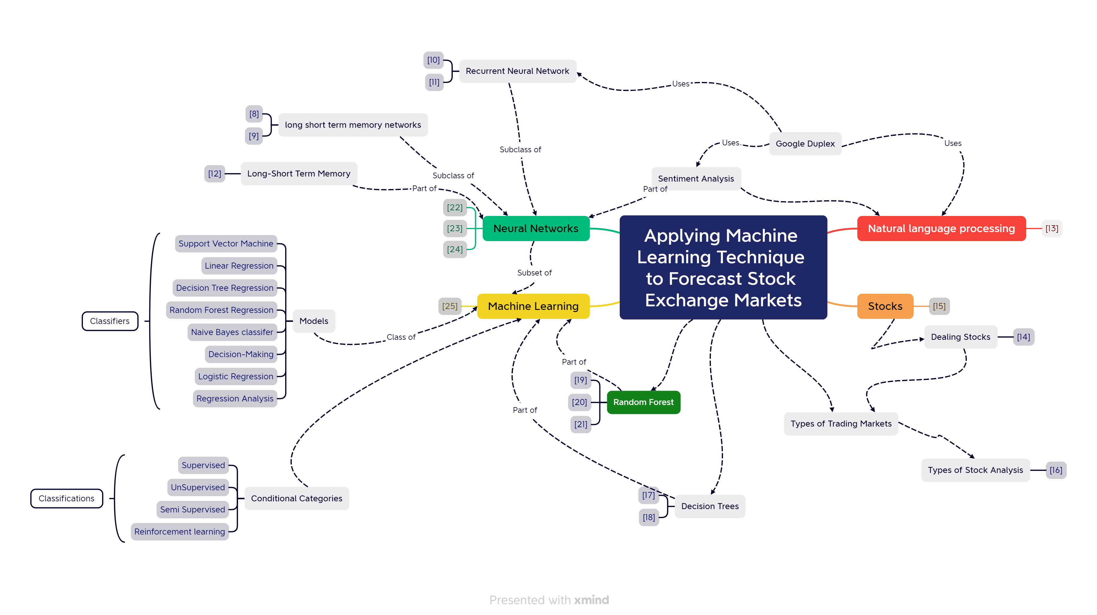
Literature Map

Slide 6
Explanation of the Literature Map
Natural Language Processing
NPL is the process that classifies RNN into different labels or classes.
[5] provided a study focusing on ANN and RNN classifications to present an up-to-date stock market forecasting based on the computational intelligent methods mentioned.
Neural Network
This paper by [4], provides insight into the architecture of artificial neural network model for forecasting stock price, including metrics indicators, performance of the network and data-collection, Recurrent Neural Network
Machine Learning
As machine learning has proven to be more accurate and efficient in predicting price movement several techniques have shown promise in improving the accuracy of different ML models.
Stocks
represents ownership in a corporation and signifies a claim on the company's assets and earnings, often referred to as "equities."

Slide 7

Data Collection
The chosen research methodology for this study is a combination of quantitative analysis and machine learning techniques.
The experiment design will involve collecting historical datasets of exchange rated and corresponding market movements over a specific time period.
The datasets will be divided into two subsets: a training set and a testing set.
Emphasis was placed on using close price as the processors to forecast result on.
As for machine learning technique, a machine learning algorithm will be employed to predict stock market movements based on past exchange rates. Such as neural network.
Lastly, for method of analysis the quantitative analysis will involve conducing statistical analysis on the trained dataset. As for machine learning techniques, various machine learning algorithms will be employed to predict stock market movements based on past exchange rates.

Slide 8
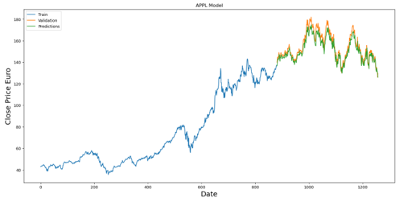
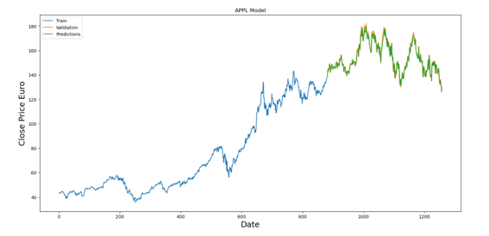
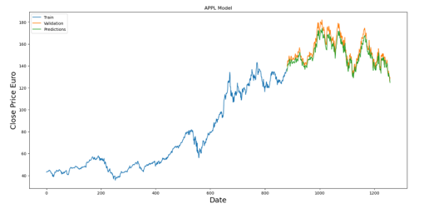
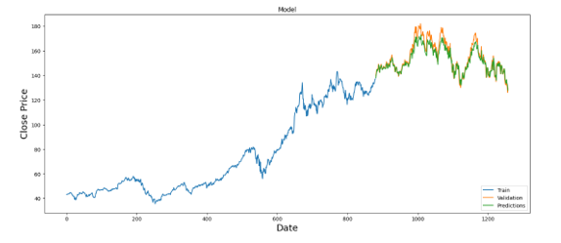
Results
The model shown excellent performance and accuracy in prediction across different test configurations:
Config 1: 97.77%
Config 2: 98.17%
Config 3: 97.92%
Config 4: 97.87%

Slide 9

Analysis and Interpretation
The model shown excellent performance and accuracy across different test configurations, with results ranging between 97% and 98%.
The results indicate the models ability to forecast the markets close price with a high accuracy.
It is noteworthy that all configurations achieved accuracy percentages above 97% when using AAPL's historical data.
When comparing the results with other studies, it is important to consider the dataset characteristics and the specific task at hand.

Slide 10
Comparison with other existing solutions
Potential benefits to the finance industry:
It was noted previously that the majority of the markets outputted high results.
Accuracy level in this study:
It was noted that the model performed rather well. It was noted previously that the majority of the markets outputted high results. This along with the performance noted proves that the hypothesis can be true
Comparing with existing solutions:
Compared with other studies that investigated their model’s performance with LSTM, the implementation model was able to forecast as accurately as the results found in this study, and also proven by [3] study was able to deliver a similar accurate ensemble model.

Slide 11

Conclusion
The hypothesis of this research stated that the possibility of maximizing profitability by implementing machine learning to improve decision making is composed of a number of factors which have to be taken into account before implementing any algorithms.
The target feature used in the LSTM model was the close price of the stock market. The Figures show different sets of stock markets being predicted, indicating that the investigation did not find a significant difference when utilizing other features from the stock market dataset.
Due to time constraints, this study focused on analysing one financial market APPL, using a single AI model Long Short-Term Memory (LSTM).
Further research could focus on using the attribute, which represents the last transacted price of the day, for stock market prediction.
Further research can focus on developing models that can adapt and update predictions in real-time as new market data becomes available

Slide 12
References
[1] M. Mailoc, Advances in financial machine learning. Hoboken, New Jersey: John Wiley & Sons, Inc, 2018.
[2] Z. Hu, Y. Zhao, and M. Khushi, “A Survey of Forex and Stock Price Prediction Using Deep Learning,” Applied System Innovation, vol. 4, no. 1, p. 9, Feb. 2021, doi: https://doi.org/10.3390/asi4010009.
[3] A. Moghar and M. Hamiche, “Stock Market Prediction Using LSTM Recurrent Neural Network,” Procedia Computer Science, vol. 170, pp. 1168–1173, 2020, doi: https://doi.org/10.1016/j.procs.2020.03.049.
[4] G. Dutta, P. Jha, A. K. Laha, and N. Mohan, “Artificial Neural Network Models for Forecasting Stock Price Index in the Bombay Stock Exchange,” Journal of Emerging Market Finance, vol. 5, no. 3, pp. 283–295, Dec. 2006, doi: https://doi.org/10.1177/097265270600500305.
[5] F. Z. Xing, E. Cambria, and R. E. Welsch, “Natural language based financial forecasting: a survey,” Artificial Intelligence Review, vol. 50, no. 1, pp. 49–73, Oct. 2017, doi: https://doi.org/10.1007/s10462-017-9588-9.

Slide 13
Thank You

